Slide 1
Contents
HTML Tags, Structure, HTML Coding Conventions - Block Elements, Text Elements, Code- Related Elements, Character References - Lists, Images, section, article, and aside Elements - nav and a Elements - header and footer Elements.

Slide 2
HTML Tags, Structure, HTML Coding Conventions
To Create Web pages.
Uses tags, to tell the Web browser software how to display the text
contained in the document
HTML tags are not case sensitive
HTML documents are described by HTML tags
File Extension: .html, .htm, .xhtml
Tools:
Notepad++, Eclipse, Netbeans,Visual Studio
Web Browsers (Internet Explorer, Firefox, Chrome, etc..)

Slide 3
Introduction
•HTML stands for Hyper Text Markup Language
•Markup language is language of writing layout information within documents
•Berners-lee defined HTML 1.0 in 1990
HTML 2.0 was released in 1995
•In January 1997, HTML 3.2 became the official standard.
•In December of 1997, HTML 4.0 was published as a recommendation by the W3C.
HTML 4.01 is a revised version of HTML 4.0 that includes several changes to the HTML specification.
•In 1998, W3C introduced eXtensible Markup Language(XML)
XHTML is the next phase in the evolution of HTML.
•W3C introduced HTML 5.0 which is finalized in October 2014

Slide 4
HTML Coding Conventions
Coding conventions make the software more readable and make it easier for engineers to comprehend new code
Declaration of Document Type
  The DOCTYPE declaration is an instruction to the web browser about what version of HTML the page is written in.
  All HTML documents must start with a <!DOCTYPE> declaration.
  The declaration is not an HTML tag. It is an "information" to the browser about what document type to expect
  In HTML 5, the declaration is simple: <!DOCTYPE html>

Slide 5
2.Use of Meta tag and Viewport
The metadata about the HTML document is displayed using the HTML
<meta> tag.
The page description, keywords, copyright, language, document creator, etc. comes under the metadata.
Although the metadata is not visible on the webpage, search engines, browsers, and other online services that scan the site or webpage utilize it to learn about the webpage.
Viewport: The viewport in a browser refers to the area of a web page that a user may see. The screen sizes of the devices used to view the website have an impact on the viewport's size. A laptop's viewport is greater than that of a phone or tablet.

Slide 6
<meta charset="utf-8" name="viewport“content= "width=device-width, initial-scale=1.0">
The width=device-width part sets the width of the page to follow the
screen-width of the device (which will vary depending on the device).
The initial-scale=1.0 part sets the initial zoom level when the page is first loaded by the browser.
charset="utf-8" :Unicode Transformation Format specifies the character encoding for the HTML document UTF-8 character set, which covers almost all of the characters and symbols in the world!

Slide 7
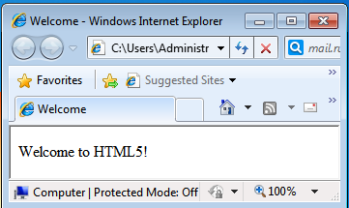
First HTML5 Example
<!DOCTYPE html>
<html>
<head>
<meta charset = "utf-8">
<title>Welcome</title>
</head>
<body>
<p>Welcome to HTML5!</p>
</body>
</html>
Unicode Transformation Format specifies the character encoding for the HTML document UTF-8 character set, which covers almost all of the characters and symbols in the world!

Slide 8
Description
¨The <!DOCTYPE html> declaration defines this document to be
HTML5
¨The text between <html> and </html> describes an HTML document
¨The text between <head> and </head> provides information about
the document
¨The text between <title> and </title> provides a title for the
document
¨The text between <body> and </body> describes the visible page
content
¨The text between <h1> and </h1> describes a heading
¨The text between <p> and </p> describes a paragraph

Slide 9
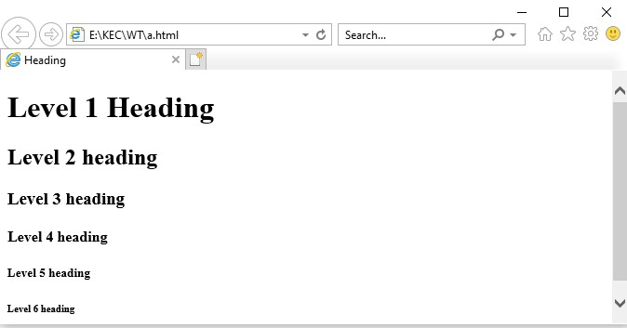
Headings
<!DOCTYPE html>
<html>
<head>
<meta charset = "utf-8">
<title>Heading</title>
</head>
<body>
<h1>Level 1 Heading</h1>
<h2>Level 2 heading</h2>
<h3>Level 3 heading</h3>
<h4>Level 4 heading</h4>
<h5>Level 5 heading</h5>
<h6>Level 6 heading</h6>
</body>
</html>

Slide 10
Formatting Text
Tags
<p>- Align paragraph
<br> or <br/>- Single line break
<pre>- preserve the white spaces and lines in the text
<div>- Make division of sections in the html document

Slide 11
<!DOCTYPE html>
<html>
<head>
<meta charset = "utf-8">
<title>formatting text</title>
</head>
<body>
<p>
The name India is derived from Indus, which is derived from the Old Persian word Hindu, from
Sanskrit
</p>
<div>
India is the seventh-largest country by geographical area. The second-most populous country with over 1.2 billion people. The most populous democracy in the world.
</div>
<pre>
Chennai being the fourth most populous metropolitan area and the fifth most populous city in India It is also the world's 36th largest metropolitan area
Cricket is the most popular sport in Chennai
Chennai is the base for the large Tamil movie industry, known as Kollywood, home to most of the
movie studios
</pre>
</body>
</html>

Slide 12
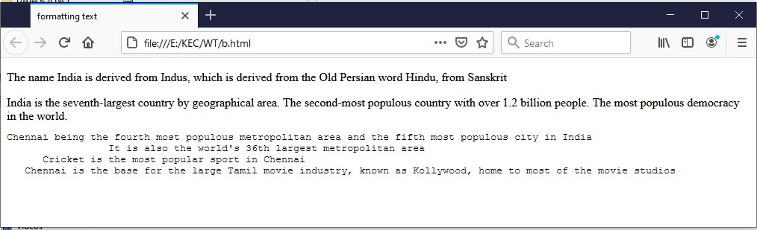

Slide 13
Setting Font Style
<!DOCTYPE html>
<html>
<head>
<meta charset = "utf-8">
<title>setting font style</title>
</head>
<body>
<b>welcome to VIT University</b><br>
<i>welcome to VIT University </i><br>
<strong>welcome to VIT University</strong><br>
<strike>welcome to VIT University </strike><br>
<center>welcome to VIT college</center><br></body>
</html>

Slide 14
Setting Font and Colors
<!DOCTYPE html>
<html>
<head>
<meta charset = "utf-8">
<title>setting font and colors</title>
</head>
<body bgcolor=”blue”>
<h1>India</h1>
<font face="arial" color="red" size="5">
India is a country that occupies the greater part of South Asia<br>
<font face="timesnewroman" color="green" size="6">
India is a country that occupies the greater part of South Asia
</body>
</html>

Slide 15
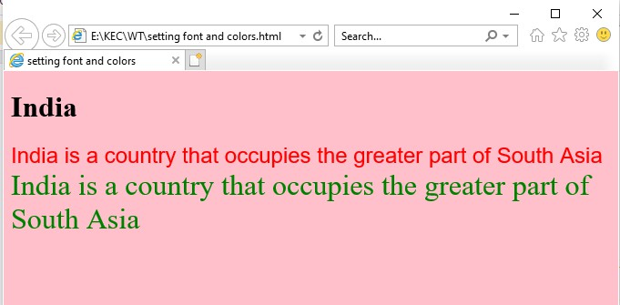

Slide 16
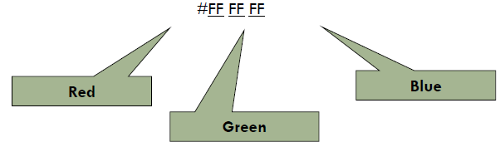
Colors:
Color is the combination of red green and blue
color = “red”
color=rgb(122,255,0)
color = “#FF0000”
values vary from 00 to FF (hexadecimal) 0,1,2,3,4,5,6,7,8,9,a,b,c,d,e,f

Slide 17
HTML Empty Tags
<hr> horizontal rule
The <hr> tag defines a thematic break in an HTML page
Thematic breaks are breaks between two themes, usually placed between two
paragraphs
It is most often displayed as a horizontal rule
<br> -line break
To display in next line in web page
No ending tag

Slide 18
Horizontal Rules
<!DOCTYPE html>
<html>
<head>
<meta charset = "utf-8">
<title>horizontal rules</title>
</head>
<body bgcolor="pink">
<h1>India</h1>
<hr/>
<font face="arial" color="red" size="5">
India is a country that occupies the greater part of South Asia<br>
<font face="timesnewroman" color="green" size="6">
India is a country that occupies the greater part of South Asia
</body>
</html>

Slide 19
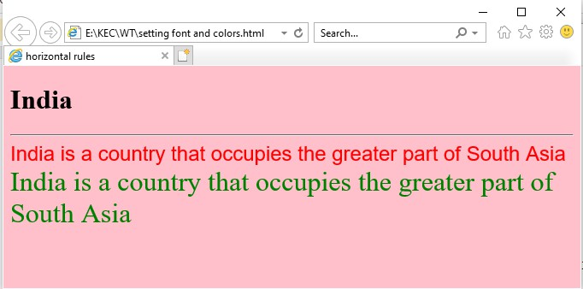

Slide 20
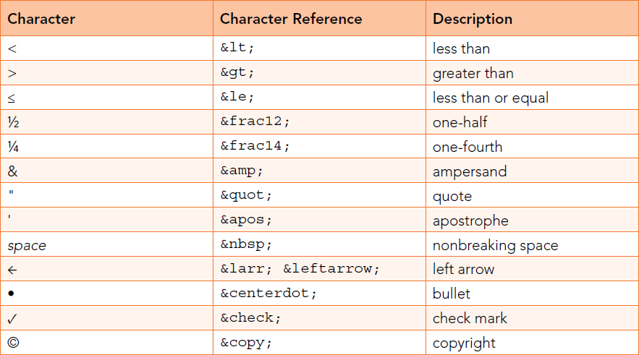
Character References

Slide 21

<!DOCTYPE html>
<html>
<body>
<h1>HTML Entity Example</h1>
<h2>The characters are: &lt; &gt; &le; &frac12; &frac14; &amp;</h2>
</body>
</html>

Slide 22
Image
Images can be included using img element
Attributes:
src: The image file’s location is specified with the src (source)
attribute(relative path)
alt: text description of image. If a browser cannot render an
image, the browser displays the alt attribute’s value.
height / width: Dimensions of area that image will occupy (it is measured in pixels(picture elements)
Void Elements:
  Some HTML5 elements (called void elements) contain only attributes and do not mark up text (i.e., text is not placed between a start and an end tag).
  you can terminate void elements (such as the img element) by using the forward slash character (/) inside the closing right angle bracket (>).

Slide 23
<!DOCTYPE html>
<html>
<head>
<meta charset = "utf-8">
<title>Image</title>
</head>
<body>
<img src = "rose.jpg" width = "300" height = "300" alt = "rose"/>
<img src = "ros.jpg" width = "300" height = "300" alt = "RED ROSE"/>
</body>
</html>

Slide 24
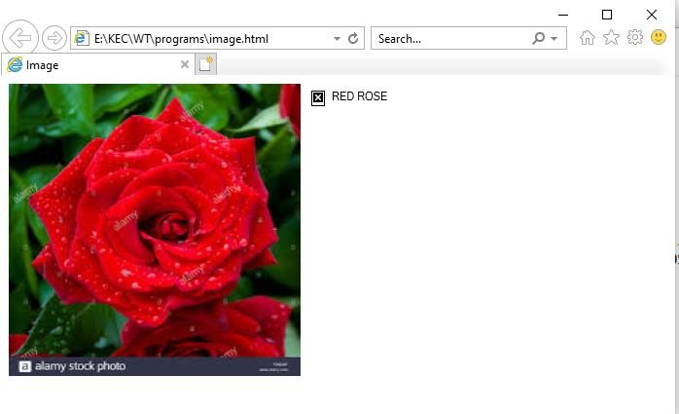

Slide 25
List
HTML lists allow web developers to group a set of related items in lists.
Types:
ordered list
An ordered list starts with the <ol> tag. Each list item starts with the <li> tag.
The list items will be marked with numbers by default
unordered list
  A list that does not order its items by letter or number
  An unordered list starts with the <ul> tag. Each list item starts with the <li> tag.
  The list items will be marked with bullets (disc) by default

Slide 26
Unordered list
<!DOCTYPE html>
<html>
<ul type="square">
<li>Coffee</li>
<li>Tea</li>
<li>Milk</li>
<head>
<meta charset = "utf-8">
<title>Unordered list</title>
</head>
<body>
<h1> My favorite drinking items
</h1>
<ul>
<li>Coffee</li>
<li>Tea</li>
<li>Milk</li>
</ul>
<ul type="circle">
<li>Coffee</li>
<li>Tea</li>
<li>Milk</li>
</ul>
</ul>
</body>
</html>

Slide 27
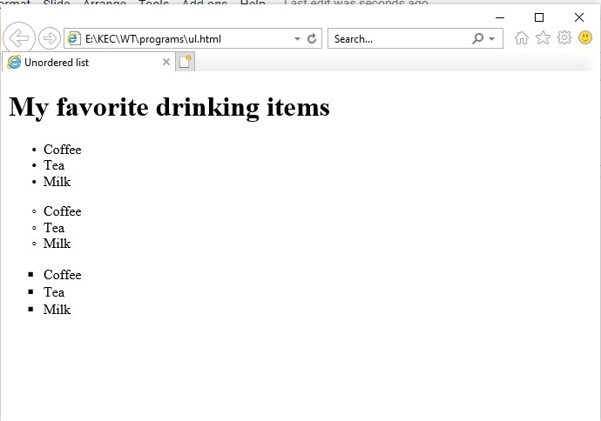

Slide 28
Ordered list
<!DOCTYPE html>
<html>
<ol type="i">
<li>Coffee</li>
<li>Tea</li>
<li>Milk</li>
</ol>
</body>
</html>
<head>
<meta charset = "utf-8">
<title>Ordered list</title>
</head>
<body>
<h1> My favorite drinking items </h1>
<ol type="A">
<li>Coffee</li>
<li>Tea</li>
<li>Milk</li>
</ol>
<ol>
<li>Coffee</li>
<li>Tea</li>
<li>Milk</li>
</ol>

Slide 29
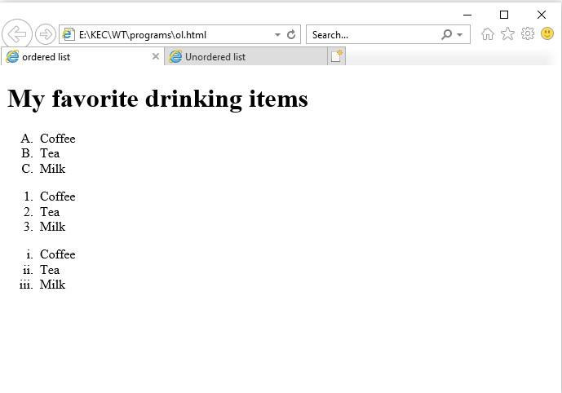

Slide 30
Nested list
Lists may be nested to represent hierarchical relationships, as in a multilevel outline
A nested list is simply a list that occurs as an element of another list

Slide 31
<!DOCTYPE html>
<html>
<head>
<meta charset = "utf-8">
<title>nested list</title>
</head>
<body>
<h1> My favorite items </h1>
<ol>
<li>Food items
<ul><li>biriyani</li>
<li>dosai</li>
<li>chicken rice</li>
</ul>
</li>
<li>Drinking items
<ul><li>coffee</li>
<li>tea</li>
<li>milk</li>
</ul>
</li>
</ol>
</body>
</html>

Slide 32
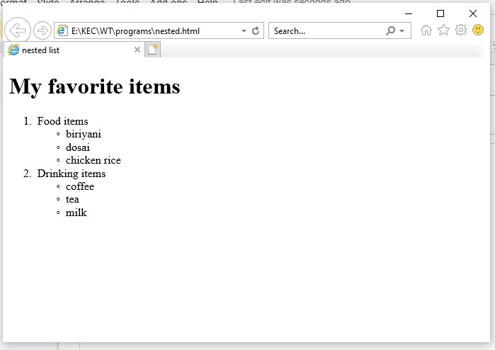

Slide 33
Table
Tables are frequently used to organize data into rows and columns.
Tables are defined with the table element
The caption element specifies a table’s title
A table has three distinct sections—head, body and foot
The head section is defined with a thead element which contains header information such as column names.
Each tr element defines an individual table row.th (table heading)
Each td element defines an individual table data(column).
The body section, or table body, contains the table’s primary data is defined in a
tbody element.
The tfoot section is defined with a tfoot (table foot) element. The text placed
in the footer commonly includes calculation results and footnotes.

Slide 34
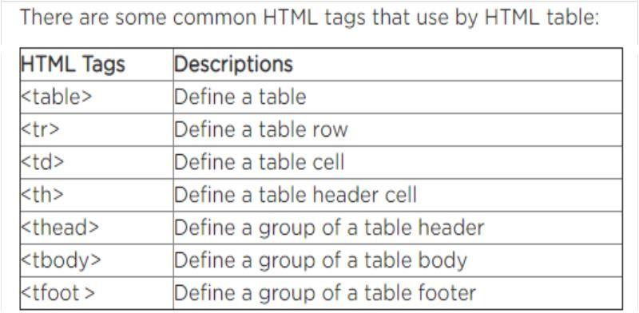

Slide 35
<tr>
<!DOCTYPE html>
<html>
<td>Banana</td>
<head>
<td>$1.50</td>
<meta charset = "utf-8">
</tr>
<tr>
<td>Pineapple</td>
<td>$2.50</td>
<title>Table</title>
</head>
<body>
<table border = "1">
<caption><strong>Table of Fruits and Their Prices</strong>
</caption>
</tr>
<thead>
</tbody>
<tfoot>
<tr>
<th>Fruit</th>
<th>Price</th>
<tr>
<th>Total</th>
<th>$7.00</th>
</tr>
</tfoot>
</table>
</body>
</html>
</tr>
</thead>
<tbody>
<tr>
<td>Apple</td>
<td>$1.00</td>
</tr>
<tr>
<td>Orange</td>
<td>$2.00</td>
</tr>

Slide 36
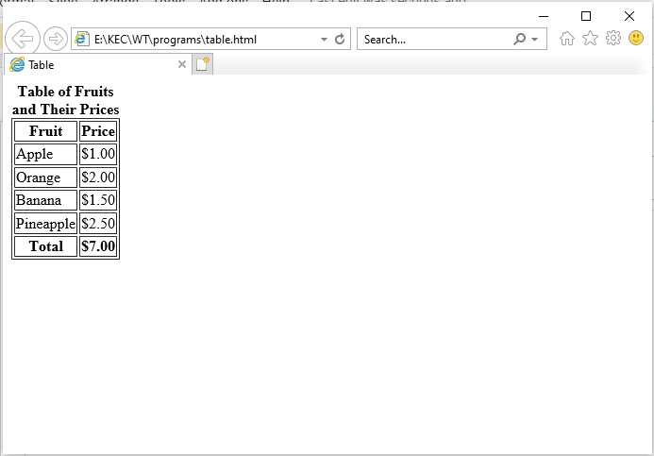

Slide 37
Using rowspan and colspan with Tables
The rowspan attribute specifies the number of rows a cell should span.
The colspan attribute defines the number of columns a cell should span.

Slide 38
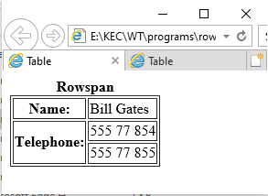
Rowspan
<!DOCTYPE html>
<html>
<head>
<meta charset = "utf-8">
<title>Table</title>
</head>
<body>
<table border = "1">
<caption><strong>Rowspan</strong></caption>
<tbody>
<tr>
<th>Name:</th>
<td>Bill Gates</td>
</tr>
<tr>
<th rowspan="2">Telephone:</th>
<td>555 77 854</td>
</tr>
<tr>
<td>555 77 855</td>
</tr>
</tbody>
</table>
</body></html>

Slide 39
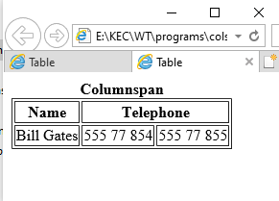
ColumnSpan
<!DOCTYPE html>
<html>
<head>
<meta charset = "utf-8">
<title>Table</title>
</head>
<body>
<table border = "1">
<caption><strong>Columnspan</strong></caption>
<tr>
<th>Name</th>
<th colspan="2">Telephone</th>
</tr>
<tr>
<td>Bill Gates</td>
<td>555 77 854</td>
<td>555 77 855</td>
</tr>
</table>
</body>
</html>

Slide 40
<!DOCTYPE html>
<html>
<head>
<meta charset = "utf-8">
<title>Table rowspan and column span</title>
</head>
<body>
<table border = "1">
<caption>A more complex sample
table</caption>
<tr>
<th rowspan = "2">RESULTS COMPARISON </th>
<th colspan = "4">
Students mark comparison
</th>
</tr>
<tr>
<th>student1</th>
<th>student2</th>
<th>student3</th>
<th>student4</th>
</tr>
<tr>
<th>Web technology</th>
<td>80</td><td>85</td><td>9 0</td><td>92</td>
</tr>
<tr>
<th>Web technology lab</th>
<td>85</td><td>95</td><td>9 0</td><td>82</td>
</tr>
</table>
</body>
</html>

Slide 41
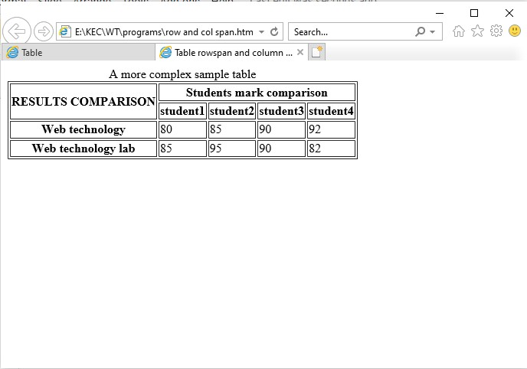

Slide 42
Linking(hyperlink)
One of the most important HTML5 features is the hyperlink, which references (or links to) other resources, such as HTML5 documents and images.
Web browsers typically underline text hyperlinks and color their text blue by default
Links are created using the a (anchor) element.
It defines a hyperlink to the URL assigned to attribute href (hypertext reference), which specifies a resource’s location, such as
  a web page or location within a web page
  a file
  an e-mail address

Slide 43
<!DOCTYPE html>
<html>
<head>
<meta charset = "utf-8">
<title>Image</title>
</head>
<body>
<h1>Here are my favorite sites:</h1>
<strong>Click a name to visit that site.</strong><br>
<a href = "http://www.facebook.com">Facebook</a><br>
<a href = "http://www.twitter.com">twitter</a><br>
<a href = "http://www.google.com">google</a><br>
</body>
</html>

Slide 44
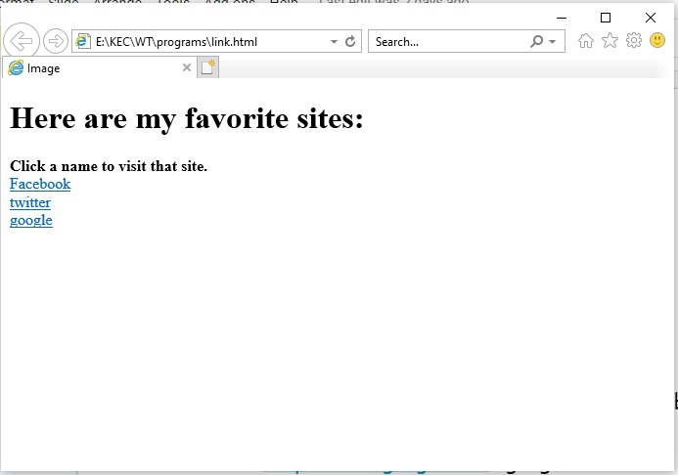

Slide 45
Hyperlinking to an E-Mail Address
<!DOCTYPE html>
<html>
<head>
<meta charset = "utf-8">
<title>link</title>
</head>
<body>
click the link
<a href = "mailto:crdhivyait@gmail.com">mail</a>
</body>
</html>

Slide 46
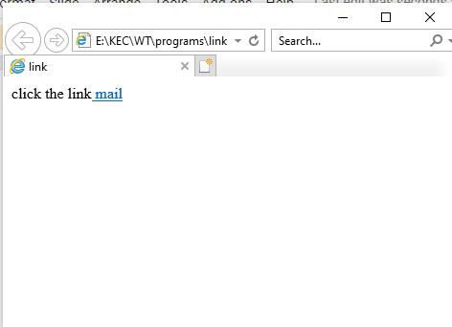

Slide 47
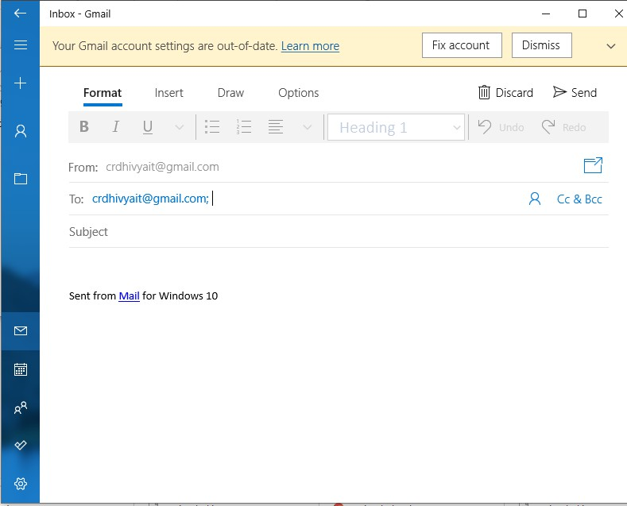

Slide 48
Link to webpage
link.html
<!DOCTYPE html>
<html>
<head>
<meta charset = "utf-8">
<title>link</title>
</head>
<body>
click the link to view image<br>
<a href = "image.html">click</a>
</body>
</html>

Slide 49
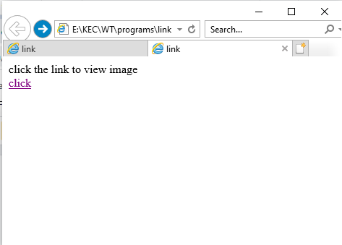

Slide 50
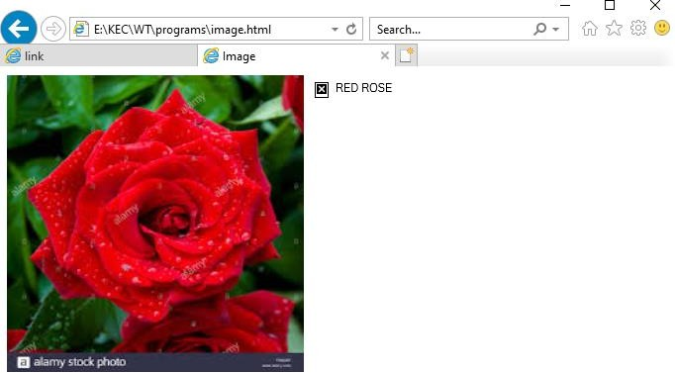

Slide 51
Using Images as Hyperlinks
tajmahal.html
<!DOCTYPE html>
<html>
<head>
<meta charset = "utf-8">
<title>link</title>
</head>
<body bgcolor="red">
<h1><center>TAJMAHAL</center></h1>
<p>The Taj Mahal was built by the Mughal emperor Shah Jahān (reigned 1628– 58) to immortalize his wife Mumtaz Mahal (“Chosen One of the Palace”), who died in childbirth in 1631, having been the emperor’s inseparable companion since their marriage in 1612.
</p>
</body>

Slide 52
imagelink.html
<!DOCTYPE html>
<html>
<head>
<meta charset = "utf-8">
<title>link</title>
</head>
<body>
click the link to view image<br>
<a href = "tajmahal.html">
<img src = "tajmahal.jpg" width = "300" height = "300" alt = "tajmahal"/>
</a>
</body>
</html>

Slide 53
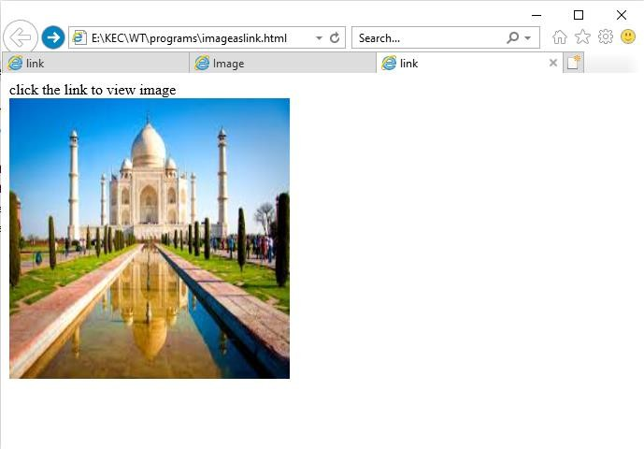

Slide 54
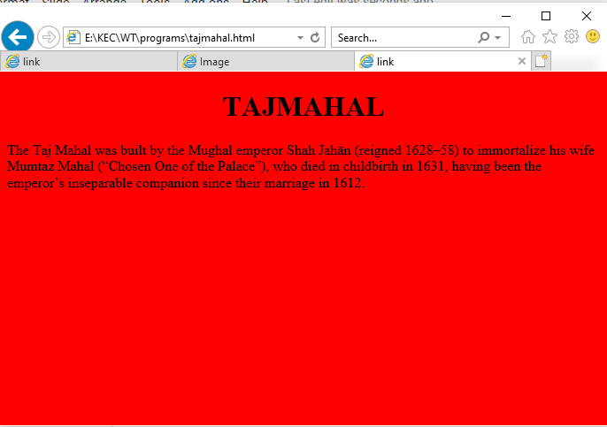

Slide 55
HTML <nav> tag
HTML <nav> tag is used to represent a section which contains navigation links, either within current document or to another document.
Examples of some navigation links are menu, table of contents, indexes, etc.

Slide 56
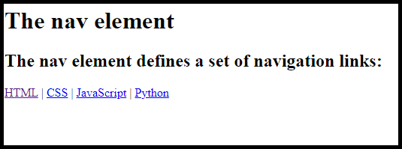
<!DOCTYPE html>
<html>
<head>
<meta charset = "utf-8">
<title>nav</title>
</head>
<body>
<h1>The nav element</h1>
<h2>The nav element defines a set of navigation links:</h2>
<nav>
<a href=“basic.html">HTML</a> |
<a href=“css.html">CSS</a> |
<a href=“javascript.html">JavaScript</a> |
<a href=“pythonbasics.html">Python</a>
</nav>
</body>
</html>

Slide 57
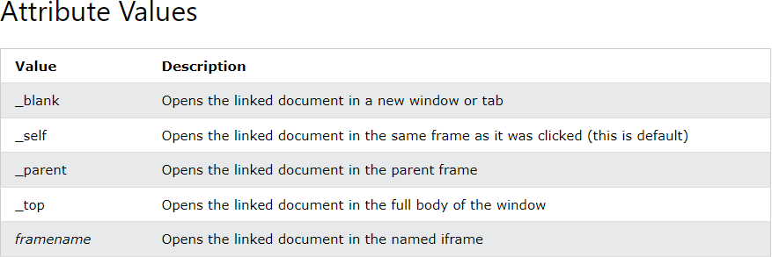
<anchor > -Target attribute value
The target attribute specifies where to open the linked document.
Example :<a href=“college.html” target=“_blank” > mycollege</a>

Slide 58
Example:
<!DOCTYPE html>
<html>
<body>
<h1>The a target attribute</h1>
<p>Open link in a new window or tab:
<a href="https://www.google.com" target="_blank">Visit google!(blank)</a></p>
<p>Open link in a new window or tab:
<a href="https://www.google.com" target="_self">Visit google!(self)</a></p></body>
</html>

Slide 59


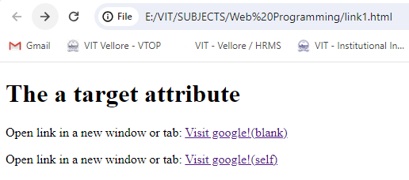
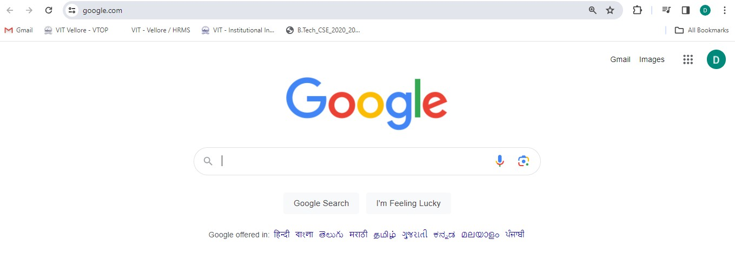

Slide 60
Internal Linking
Internal linking—a mechanism that enables the user to jump between locations in the same document.
Internal linking is useful for long documents that contain many sections.
Clicking an internal link enables the user to find a section without scrolling through the entire document.

Slide 61
<!DOCTYPE html>
<html>
<head><meta charset = "utf-8">
<title>Internal linking</title>
</head>
<body>
<img src="internet.jpg" height="200" width="200">
<h1 id = "features">The Best Features of the Internet</h1>
<a href = "#drawbacks">Go to Drawbacks of Internet</a>
<ul>
<li>You can meet people from countries around the world.</li>
<li>You have access to new media as it becomes public:
<ul>
<li>New games</li>
<li>New applications
<ul>
<li>For Business</li>
<li>For Pleasure</li>
</ul>

Slide 62
</li>
<li>Around the clock news</li>
<li>Search Engines</li>
<li>Shopping</li>
<li>Programming
<ul>
<li>HTML5</li>
<li>Java</li>
<li>Dynamic HTML</li>
<li>Scripts</li>
<li>New languages</li>
</ul>
</li>
<li>It is the technology of the future!</li>
<li>Extension of Existing IT Technology.</li>
<li>Flexibility of Communication</li>
<li>Security</li>
<li>Low Cost</li>
</ul>
<h1 id = "drawbacks">Drawbacks of Internet</h1>
<a href = "#features">Go to Favorite Features </a>
<ol>
<li>Addiction, time-waster, and causes distractions</li>
<li>Health issues and obesity.</li>
<li>Cyberbullying</li>
</ol>
</body>
</html>
</ul>
</li>
<li>Links</li>
<li>Keeping in touch with old friends</li>

Slide 63
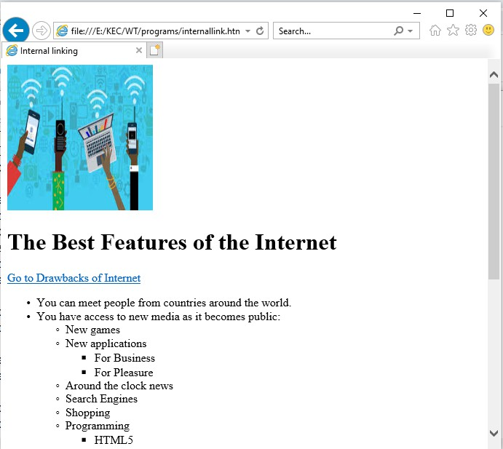
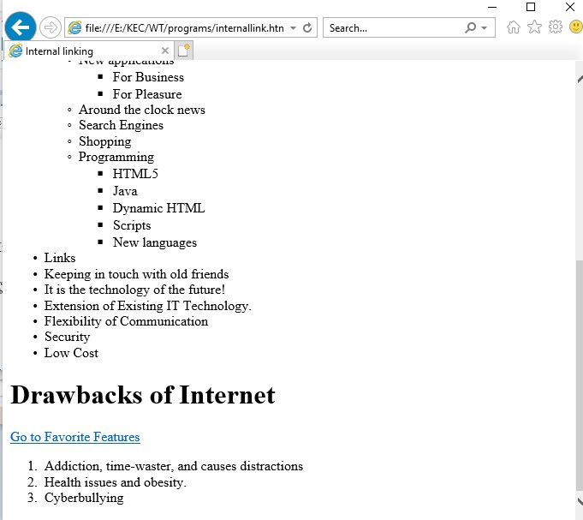

Slide 64
Frames and Frame set in HTML
HTML frames are used to divide your browser window into multiple sections where each section
can load a separate HTML document.
A collection of frames in the browser window is known as a frameset.
Instead of using body tag, use frameset tag in HTML to use frames in web browser. But this Tag is deprecated in HTML 5.
The frameset tag is used to define how to divide the browser.
Each frame is indicated by frame tag and it basically defines which HTML document shall open into the frame
To define the horizontal frames use row attribute of frame tag in HTML document and to define the vertical frames use col attribute of frame tag in HTML document.

Slide 65
<!DOCTYPE html>
<html>
<frameset cols="50%,50%">
<frame src="form.html" name="left">
<frameset rows="50%,50%">
<frame src="ol.html" name="right1">
<frame src="ul.html" name="right2">
</frameset>
</frameset>
</html>

Slide 66
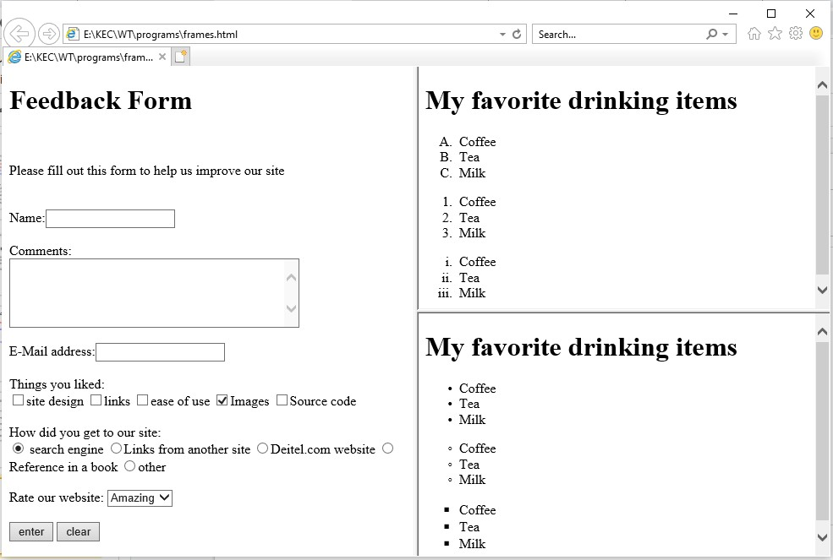

Slide 67
Frames in HTML5.0(IFrame)
An iFrame is an inline frame used inside a webpage to load another HTML document inside it.
It allows you to open new document inside the main browser's window. Inline frame is also called
floating frame.
!DOCTYPE html>
<html>
<head>
<meta charset = "utf-8">
<title>welcome</title>
</head>
<body>
<iframe src="ul.html" height="500" width="500"></iframe>
<iframe src="ol.html" height="500" width="500"></iframe>
</body>
</html>

Slide 68
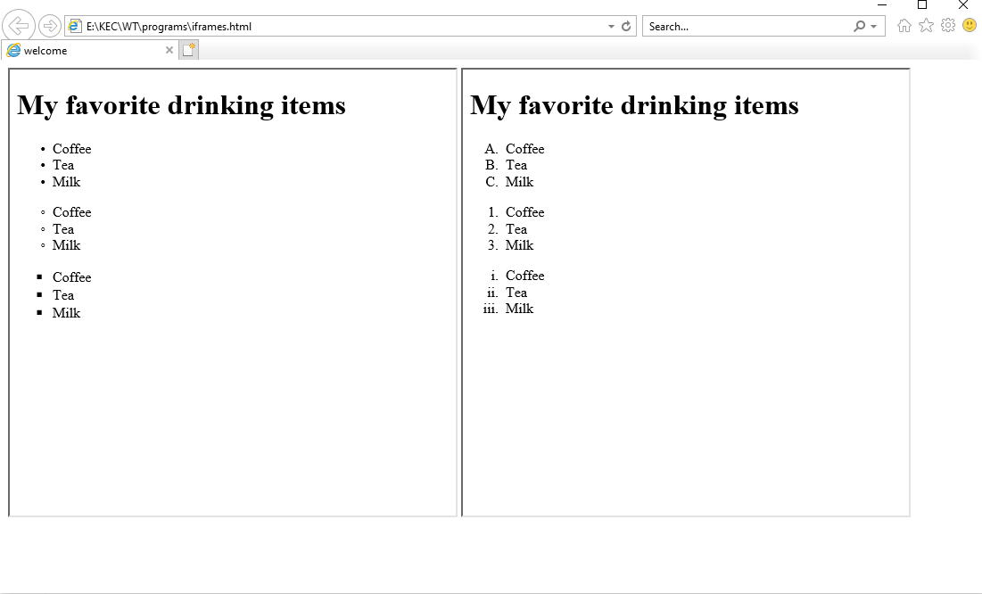

Slide 69
Iframe →<anchor > -Target attribute value
The target attribute specifies where to open the linked document.
Example :<a href=“college.html” target=“_blank” > mycollege</a>

Slide 70
home.html
Frame.html
<!DOCTYPE html>
<html>
<head>
<meta charset = "utf-8">
</head>
<body>
<iframe src="home.html" height="500“
width="500"></iframe>
</body>
</html>
<!DOCTYPE html>
<html>
<head>
<meta charset = "utf-8">
</head>
<body>
<h1> home page (Parent frame) </h1>
<iframe src="product.html" height="500" width="500"></iframe>
</body>
</html>

Slide 71
Product.html
<!DOCTYPE html>
<html>
<head>
<meta charset = "utf-8">
<title>welcome</title>
</head>
<body>
<h1> Product page(Child Frame) </h1>
<a href="mail.html" target="_parent">Visit Mail Page!!</a>
<a href="mail.html" target="_top">Visit Mail Page!!</a>
</body>
</html>

Slide 72

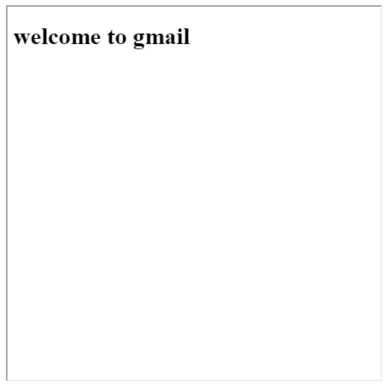
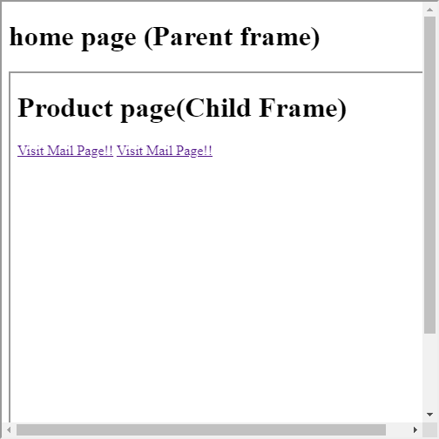

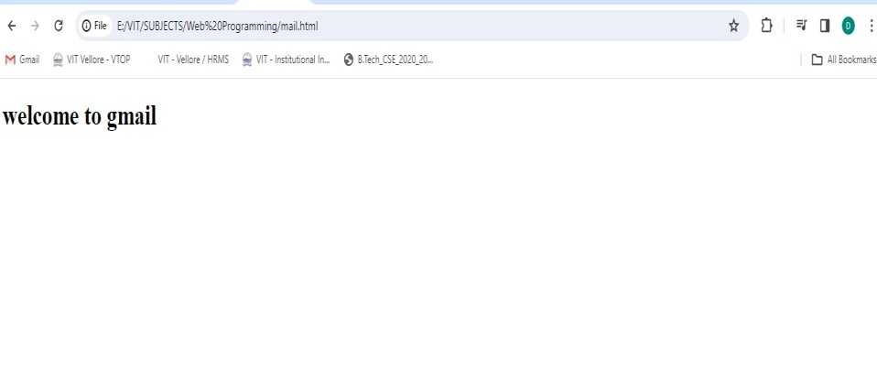

Slide 73
Target=“name attribute”
<!DOCTYPE html>
<html>
<body>
<h1>The iframe name attribute</h1>
<iframe src="home.html" name="iframe_a"></iframe><br>
<a href="product.html" target="iframe_a">Click to view Product Page</a>
</body>
</html>

Slide 74
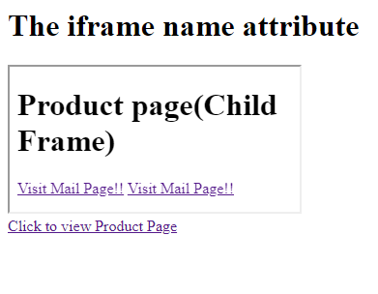
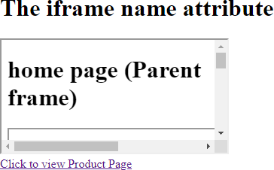

Slide 75
Media Tags
HTML5 introduced 5 most popular media element tags i.e.
<audio>, <video>. This media element tags changed the entire development using HTML.
Media Tags:
  <audio>: It is an inline element that is used to embed sound files into a web page.
  <video>: It is used to embed video files into a web page.

Slide 76
<audio>:
The “audio” tag is an inline element that is used to embed sound files into a web page.
Syntax:
<audio> <source src="sample.mp3" type="audio/mpeg"> </audio>
Attributes: The various attributes that can be used with the “audio” tag are listed
below:
Controls: Designates what controls to display with the audio player.
Autoplay: Designates that the audio file will play immediately after it loads controls.
Loop: Designates that the audio file should continuously repeat.
src: Designates the URL of the audio file.
muted: Designates that the audio file should be muted.

Slide 77
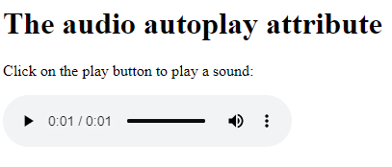
<audio> example:
<!DOCTYPE html>
<html>
<body>
<h1>The audio autoplay attribute</h1>
<p>Click on the play button to play a sound:</p>
<audio controls autoplay>
<source src="horse.ogg" type="audio/ogg">
<source src="horse.mp3" type="audio/mpeg">
</audio>
</body></html>

Slide 78
<video>:
It is used to embed video files into a web page.
Syntax:
<video> <source src="movie.mp4" type="video/mp4">
</video>
Attributes that can be used with the “video” tag are listed below :
Autoplay: It tells the browser to immediately start downloading the video and play it as soon as it can.
Preload: It intends to provide a hint to the browser about what the author thinks will lead to the best
user experience.
VALUE | DESCRIPTION
auto | Loads the entire video file when the page loads.
metadata | Only loads video metadata when the page loads.
none | Indicates that the video file will not be preloaded.
Loop: It tells the browser to automatically loop the video.

Slide 79
height: It sets the height of the video in CSS pixels.
width: It sets the width of the video in CSS pixels.
Controls: It shows the default video controls like play, pause, volume,
etc.
Muted: It mutes the audio from the video.
Poster: It loads an image to preview before the loading of the video.
src: It is used to specify the URL of the video file.

Slide 80
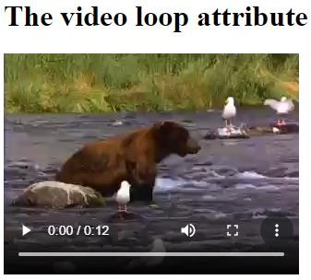
<video> example:
<!DOCTYPE html>
<html>
<body>
<h1>The video loop attribute</h1>
<video width="320" height="240" controls loop>
<source src="movie.mp4" type="video/mp4">
<source src="movie.ogg" type="video/ogg">
</video>
</body>
</html>

Slide 81
Block Elements
The div and p elements are block elements(<div> <p>)
blockquote element(<blockquote>)
  HTML <blockquote> tag is used to define a block of text which is quoted
from another source. The Browser usually displays the content within
<blockquote> tag as indented text.
  cite-It is used to specify the URL of the source from where the quote is taken.

Slide 82
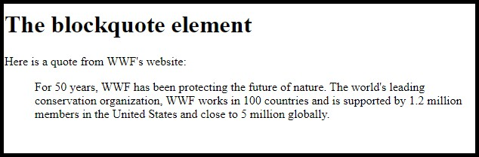
<!DOCTYPE html>
<html>
<head><meta charset = "utf-8">
<title>block elements</title></head>
<body>
<h1>The blockquote element</h1>
<p>Here is a quote from WWF's website:</p>
<blockquote cite="http://www.worldwildlife.org/who/index.html">
For 50 years, WWF has been protecting the future of nature. The world's leading conservation organization, WWF works in 100 countries and is supported by 1.2 million members in the United States and close to 5 million globally.
</blockquote>
</body>
</html>

Slide 83
Phrasing Elements
Phrasing Elements (<strong>) element :The <strong> HTML element indicates that its contents have strong importance and Browsers typically render the contents in bold type
q and cite elements: <q> <cite>: <cite> tag defines the title of a creative work and
<q> tag defines a short quotation.
dfn, abbr, and time Elements
<abbr> :defines an abbreviation
<dfn>: "definition element", and it specifies a term that is going to be defined within the content.
<time>:defines a specific time

Slide 84
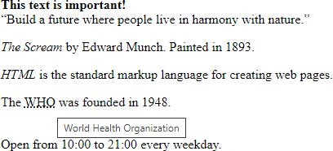
<!DOCTYPE html>
<html>
<body>
<strong>This text is important!</strong><br>
<q>Build a future where people live in harmony with nature.</q><br>
<p><cite>The Scream</cite> by Edward Munch. Painted in 1893.</p>
<p><dfn>HTML</dfn> is the standard markup language for creating web
pages.</p>
The <abbr title="World Health Organization">WHO</abbr> was founded in 1948.<br><br>
<p>Open from <time>10:00</time> to <time>21:00</time> every weekday.</p>
</body>
</html>

Slide 85
Editing Elements(<ins>, <del>) :
<ins>tag defines a text that has been inserted
document. Browsers will usually underline inserted text,
into a
<del> defines text that has been deleted from a document.
Browsers will usually strike a line through deleted text.

Slide 86

<!DOCTYPE html>
<html>
<head>
</head>
<body>
<h1>The del and ins elements + CSS</h1>
<p>My favorite color is <del>blue</del> <ins>red</ins>!</p>
</body>
</html>

Slide 87
Code Related Elements
<Code>
<kbd>
define a piece of computer code.
define keyboard input
<samp> - defines sample output from a computer program
<var> - defines a variable

Slide 88
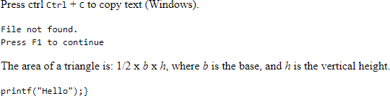
<!DOCTYPE html>
<html>
<body>
<p>Press ctrl <kbd>Ctrl</kbd> + <kbd>C</kbd> to copy text (Windows).</p>
<samp>File not found.<br>Press F1 to continue</samp>
<p>The area of a triangle is: 1/2 x <var>b</var> x <var>h</var>, where
<var>b</var> is the base, and <var>h</var> is the vertical height.</p>
<code> printf("Hello");}
</code>
</body>
</html>

Slide 89
Page-Structure Elements
header Element
  The header element creates a header for this page that contains both text and graphics. The header element can be used multiple times on a page and can include HTML headings (<h1> through <h6>), navigation, images and logos and more
footer Element
  The footer element describes a footer—content that usually appears at the bottom of the content or section element. We can use the footer to describe the copyright notice and contact information

Slide 90
section Element
  The section element describes a section of a document, usually with a heading for each section—these elements can be nested
aside Element
  The <aside> tag is used to describe the main object of the web page in a
shorter way like a highlighter.
article Element
  The article element describes standalone content that could potentially be used or distributed elsewhere, such as a news article, forum post or blog entry.

Slide 91
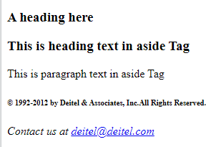
<!DOCTYPE html>
<html>
<body>
<section>
<article>
<header>
<h1>A heading here</h1>
</header>
</article>
<aside>
<h1>This is heading text in aside Tag</h1>
<p>This is paragraph text in aside Tag</p>
</aside>
</section>
<footer>
<h6>&copy; 1992-2012 by Deitel &amp; Associ<wbr>ates, Inc.All Rights Reserved.</h6>
<address>
Contact us at <a href = "mailto:deitel@deitel.com"> deitel@deitel.com</a>
</address>
</footer>
</body>
</html>

Slide 92

Exercise Problems
Design the class timetable using tables
Create a web page for the given table and fill 10 data records in the table

Slide 93
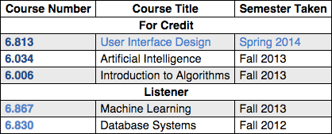
3. Design a below table and fill the data

Slide 94
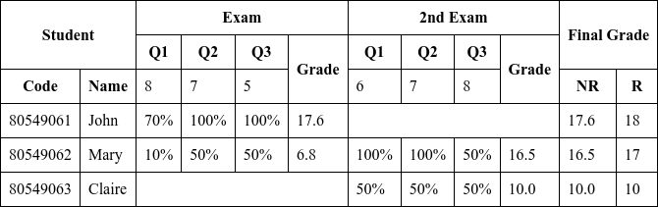
4. Create a document representing the following table

Slide 95
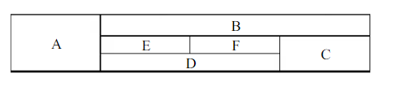
5. Write HTML code to create the table shown in the following figure:

Slide 96
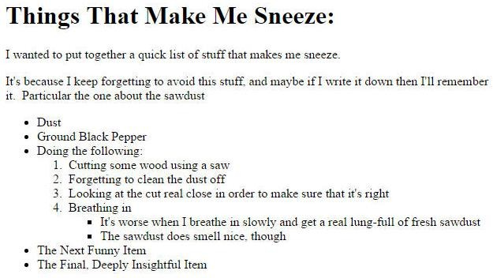
6. Create a webpage using nested list

Slide 97
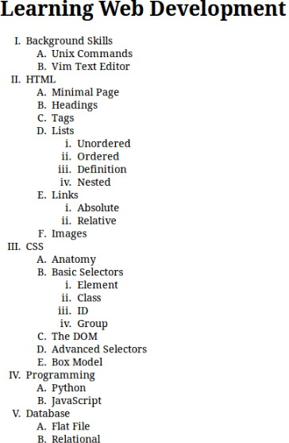
7. Design the given
web page

